Slide 1



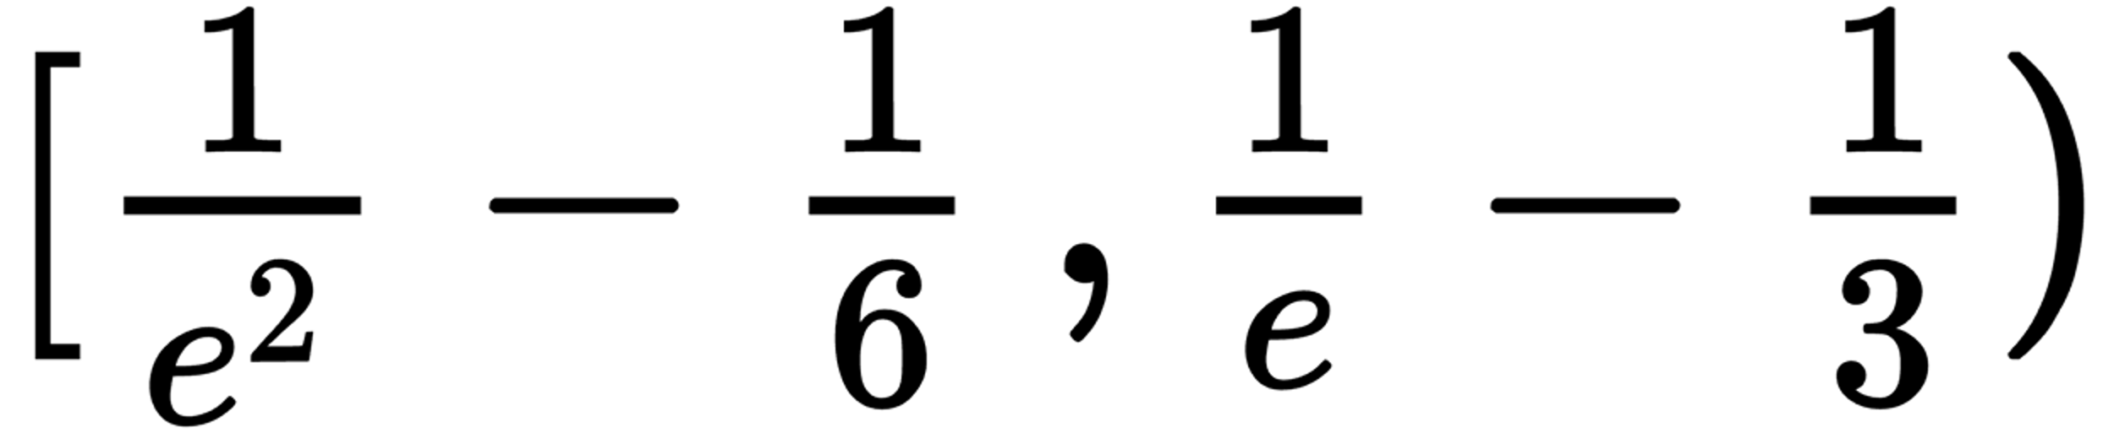



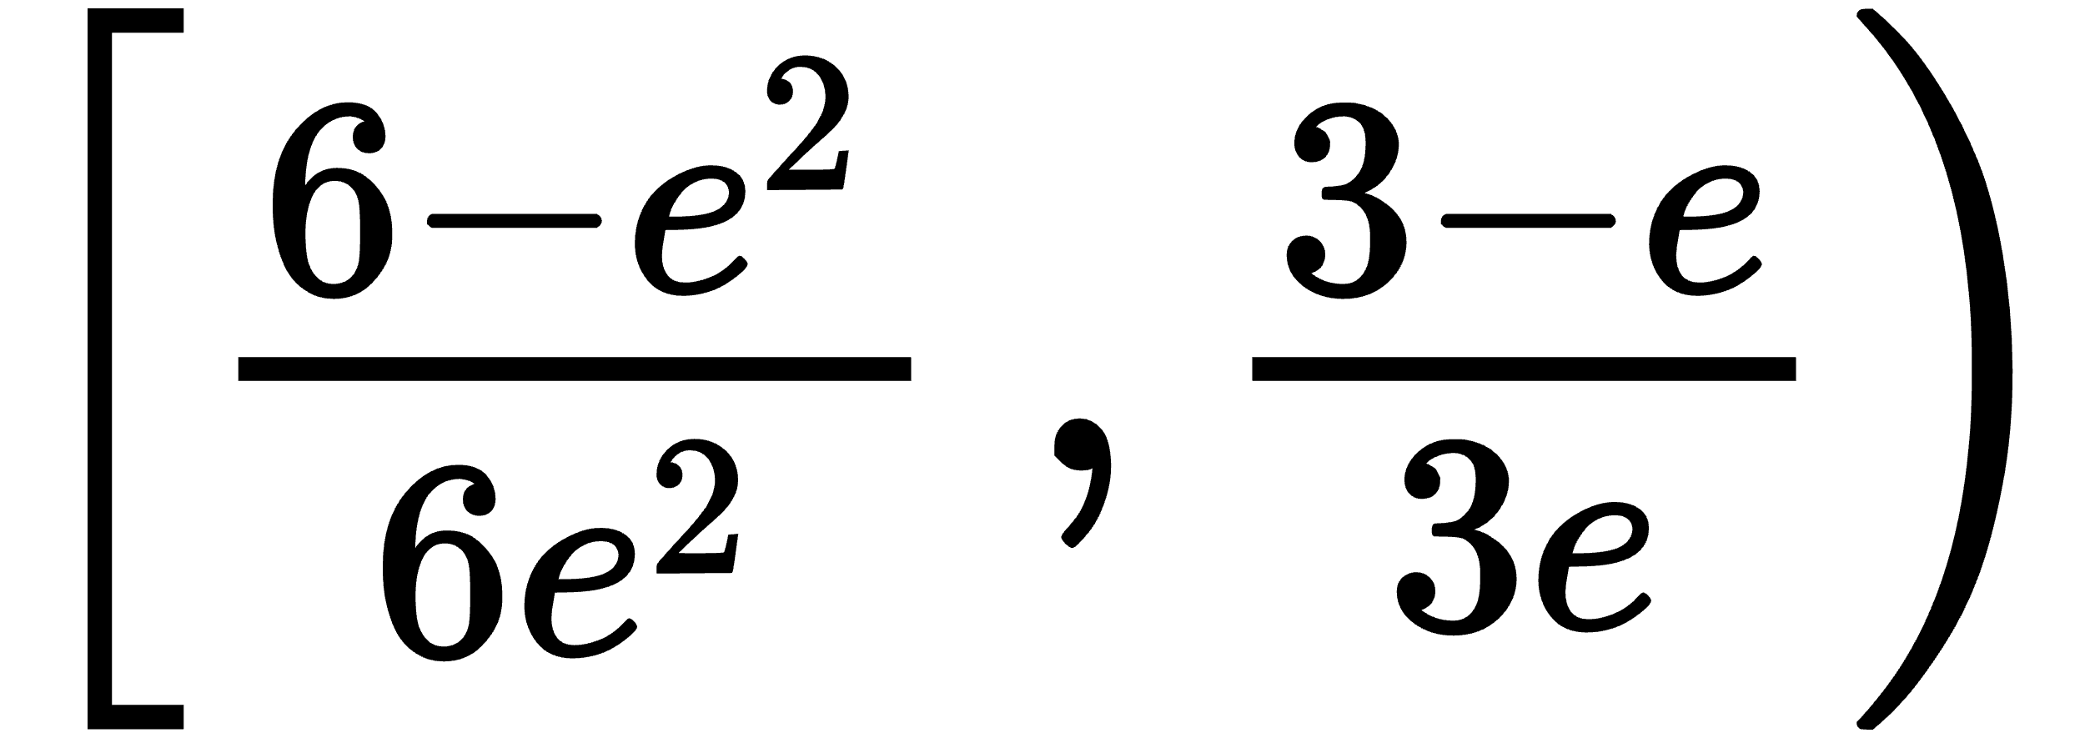
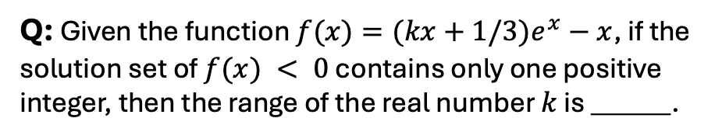
CN_K12
Q: Given the function $f(x)=(kx+1/3)e^{x}−x$, if the solution set of $f(x) < 0$ contains only one positive integer, then the range of the real number $k$ is ______.
Ground Truth
False Negative!
Wrong!
LLM
No Reward
Verifier

Slide 2













TinyV
Training
Real
FN/TN
Synthetic
FN/TN
Big-Math
LLM
SFT
Prompt
$$x$$
Ground Truth
$$y_{ref}$$
TinyV
LLM
TinyV
Deployment
$$y_{i}$$
Rule-based
Verifier
Reward $r_{i}$

Slide 3



32,406
25,915
16,488
12,462
2,316
1,880
878
865
677
594
ORCA-Math
CN_K12
Olympiads
Big-Math
AOPS
MATH
Omni-MATH
HARP
GSM8K
OpenMath
Precentage (%)

